Slide 1
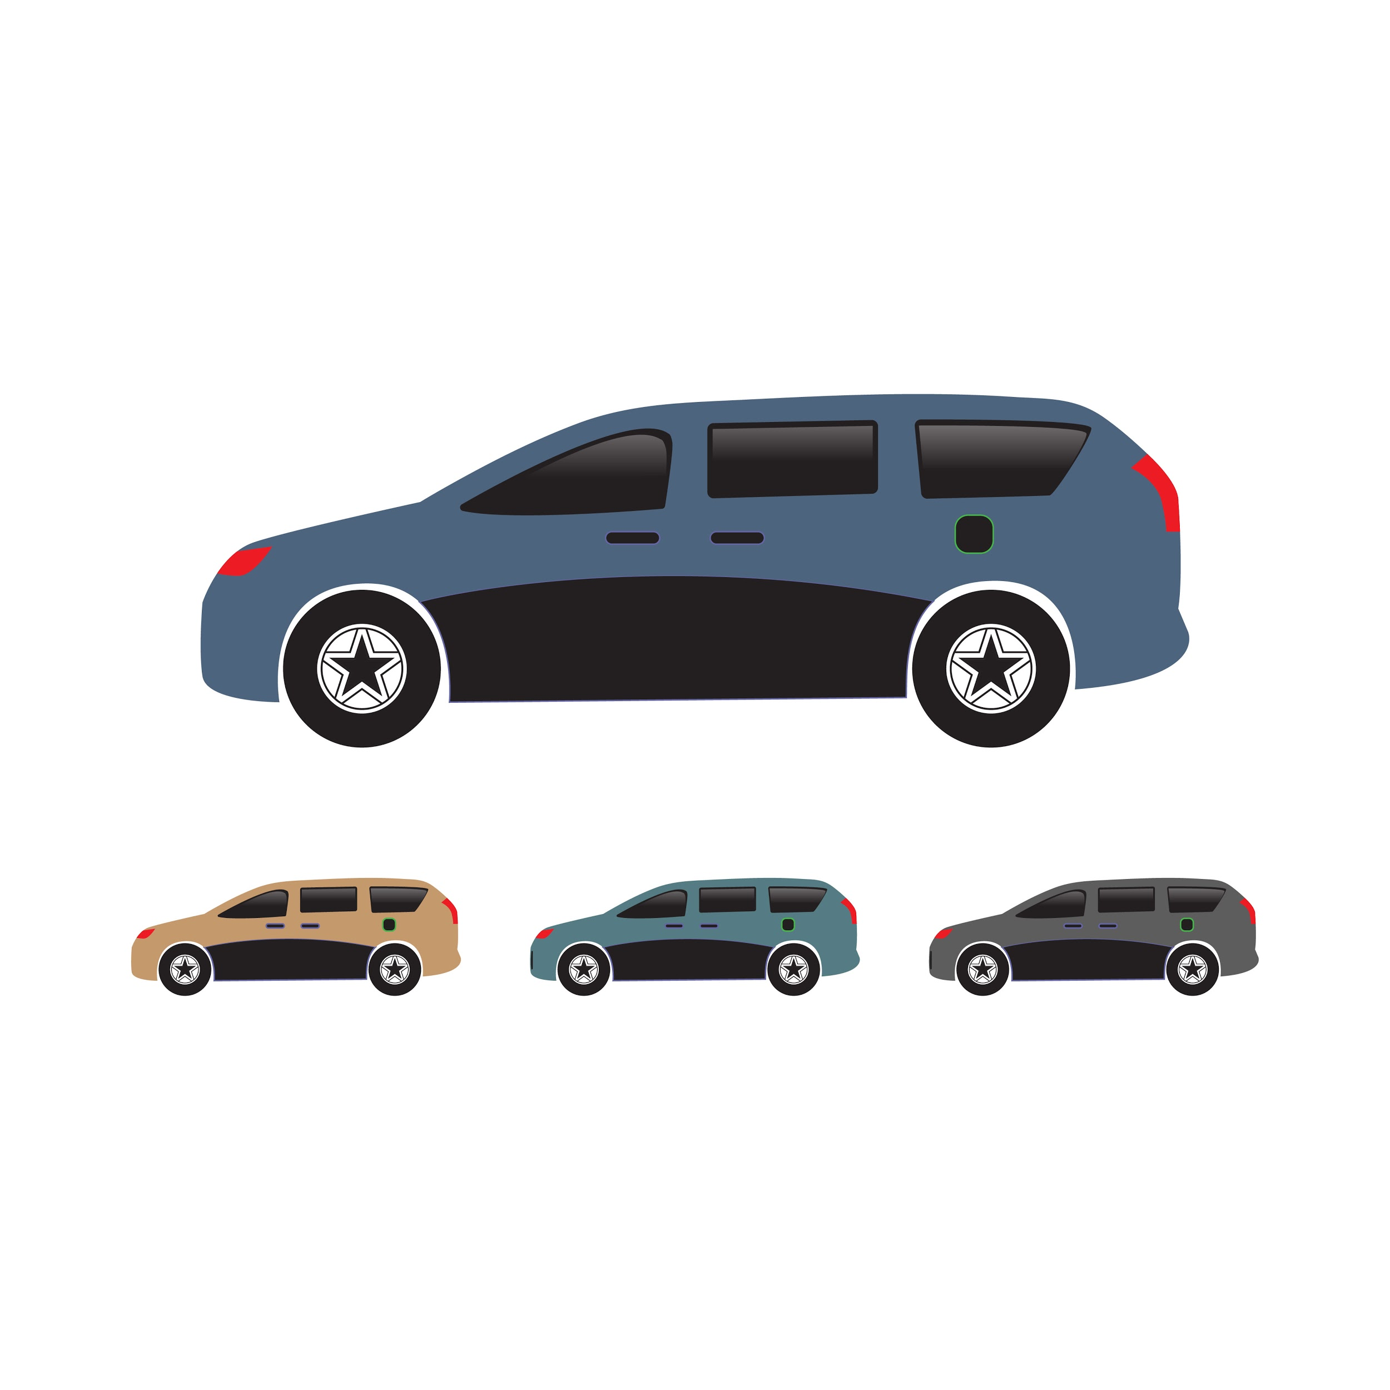
Resale Value Of
Predicting Cars
Team Members
i) A.Hemalatha
ii) K.Meena
iii) K.B.Navyasree
iv) Priya choubey
v) S.Salma

Slide 2
Introduction
Ibm cloud with Node red
Dataset used :Resale Values
Technologies used:Machine Learning ,Python,Regression(Decision tree)

Slide 3
What is Resale value prediction
“Whenever you own a car you should know that a car is a depreciating asset”
“It is imperative that you buy a car that has a good resale values so that if you must sell your car,you get a good price for it”.
“Its valuation declines with each passing year due to wear and tear”.
“Buying a car with a good resale value is even more important if you are one of those who likes to change their cars once in a couple of years”.
“You do not want to be selling your old car at a price that is way below its purchase price”.

Slide 4

Selling your idea
About the Dataset:Registration no,Fueltype,Brand,Kilometers and Price
A dataset is a collection of data .Most commonly a dataset corresponds to the contents of single dataset table.Where every column of a table represents a particular variable ,and row corresponds to a given member of data.

Slide 5
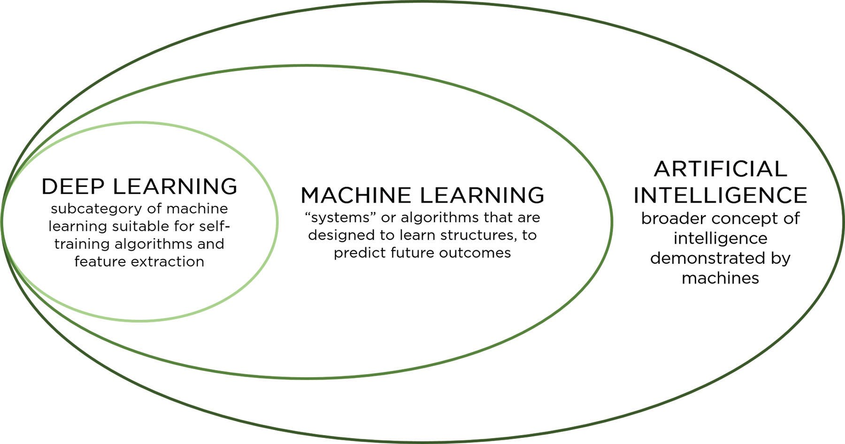

Slide 6
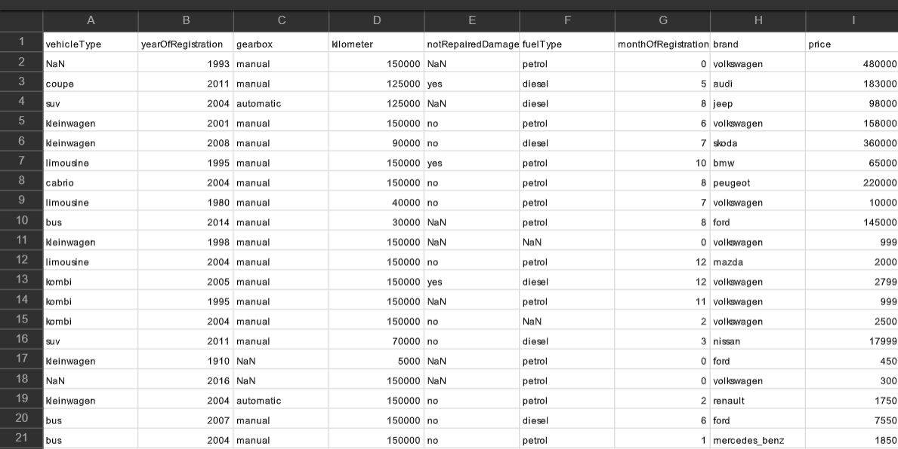

Slide 7
Advantages to Buy a Used Car
Biggest advantage to buying used is the cost savings…..
When buying used,you’re letting the original owner absorb most of the depreciation cost...
Some cars tend to depreciate a lot quicker than others...
So it’s smart to pay attention to the residual values when buying a car...

Slide 8


Owning a car is expansive and requires additional costs to maintain and repaire it...
Disadvantages of buying a used car
Tip
Don’t wait till the end of the presentation to give the bottom line.
Reveal your product or idea (in this case a translation app) up front.
Resale valued cars have increased the
level of air and noise pollution in cities….
Causing more humans to suffer from respiratory,
heart diseases and cancer etc…...
New cars come with a financing rate as low as 0%..

Slide 9
CONCLUSION: Hence we used the
machine learning algorithms to predict the resale values of car and we predicted the price…...

Slide 10
THANK YOU

